Slide 1
Deploy Report
Deploy Report

Slide 2
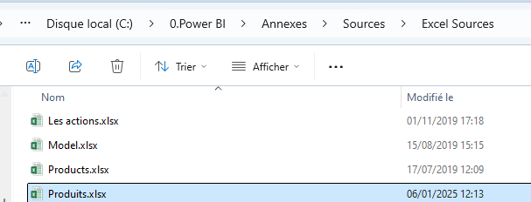
Deploy report
Note: This lab requires a Power BI Services session
Note: This is using Sample1.pbix from Produits.xlsx in the Excel Sources folder

Slide 3

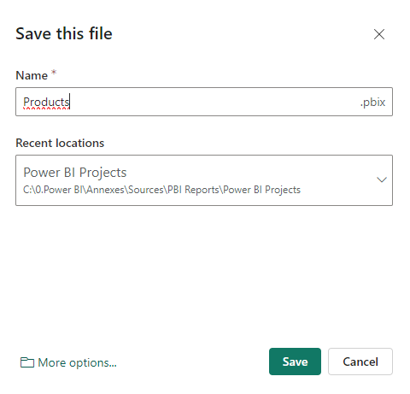
Deploy report
Save the report and publish it in the workspace of choice by clicking the Select button

Slide 4
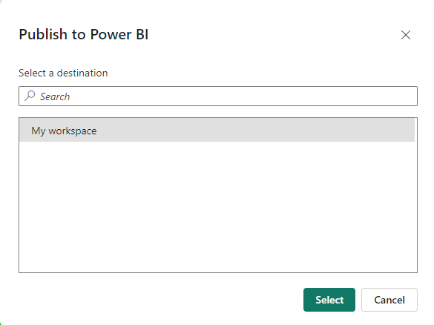
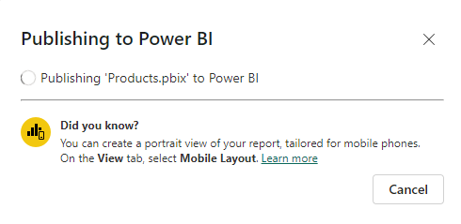
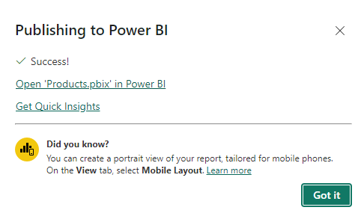
Deploy report
Select the Workspace where the report would be published Ex: My workspace
2
1
3

Slide 5
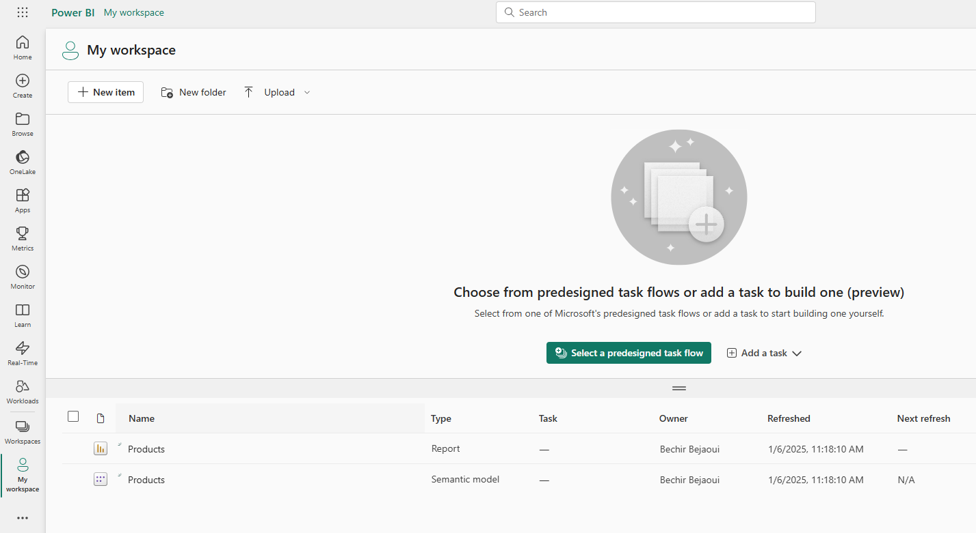
Deploy report
Note the presence of two files in the report list at My workspace Level

Slide 6
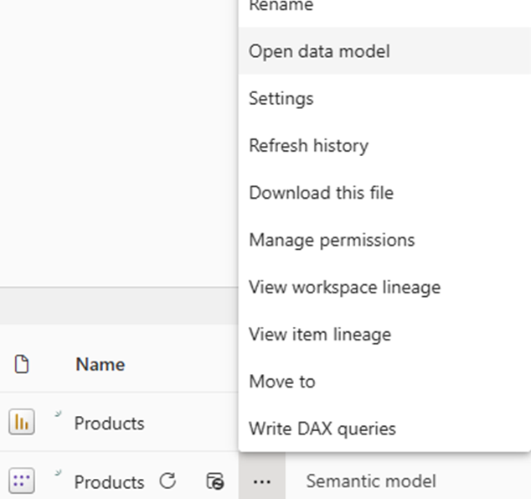
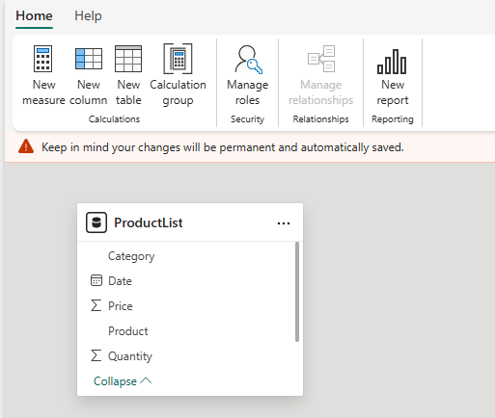
Deploy report
The second file Semantic Model is the Data model presentation that provides a structured, meaningful, and user-friendly abstraction layer for the data

Slide 7
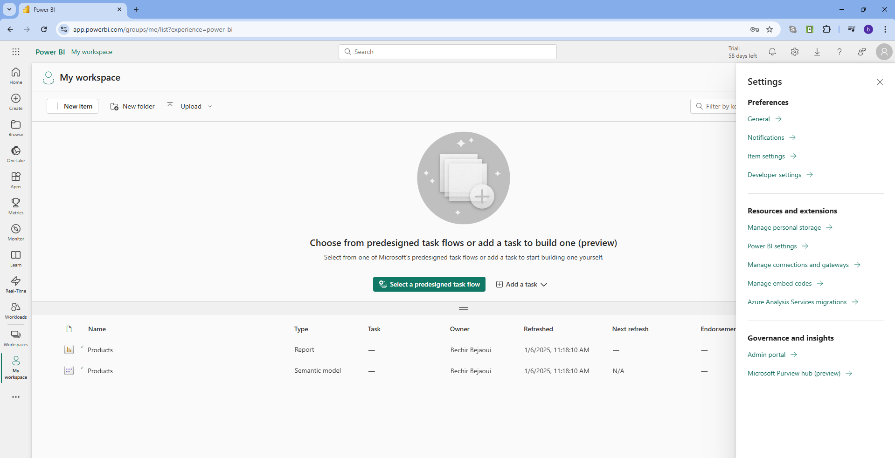
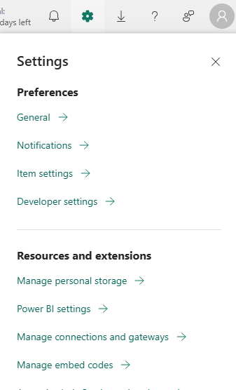
Deploy report
Then Gateway should be verified and configured correctly, to guarantee data is refreshed when it is needed
1
2

Slide 8
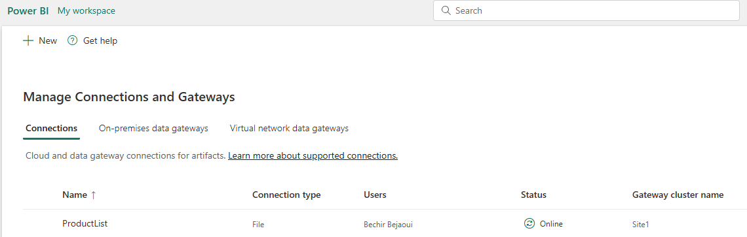
Deploy report
We should verify if connection is created and established to the on premises data source

Slide 9

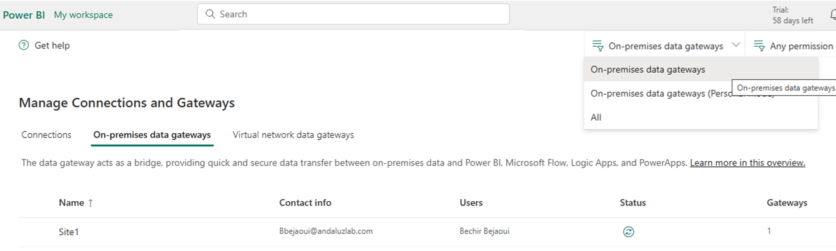

Deploy report
Otherwise we should verify the data gateway by clicking the button
The status should be showing Online

Slide 10
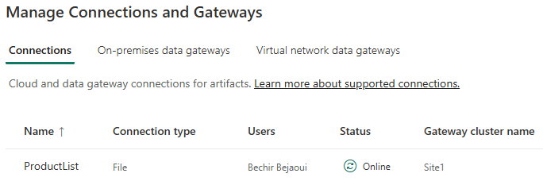
Deploy report
We should verify the connection status also

Slide 11
Deploy report
In case of connection parameter changing it is possible to update or create a connection to the data source
Note: Must have a valid Windows credentials username and password
Note: The username must follow the pattern computername \username

Slide 12
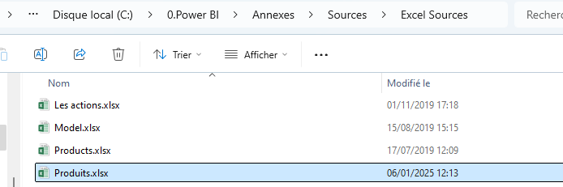
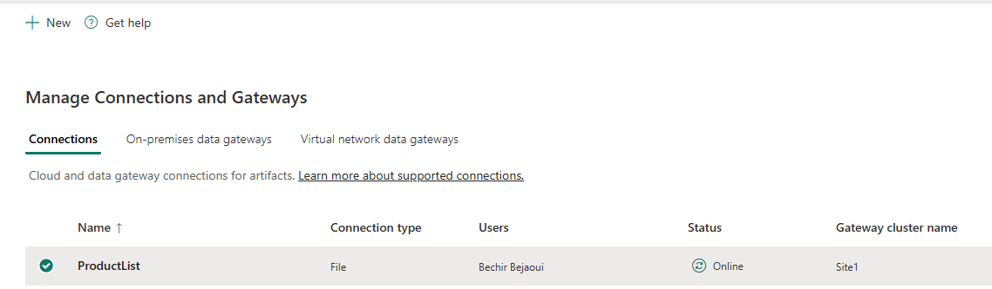
Deploy report
We suppose creating a new connection to the Excel file
Select Connections tab and appears

Slide 13
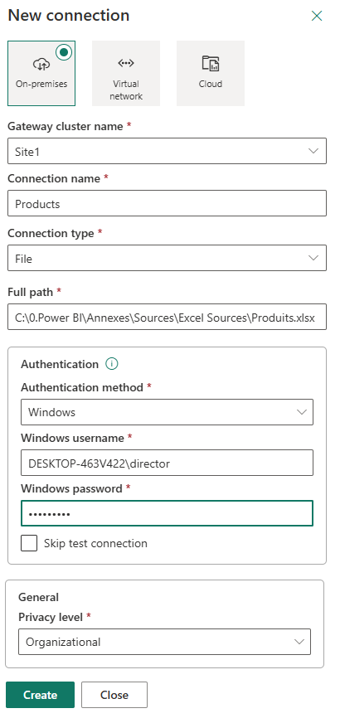
Deploy report
Click the button
1
The gateway location
6
The authentication method
7
The user name
2
The gateway name
8
The password
3
The connection name
4
The connection type
9
The privacy level
5
The data source file path

Slide 14
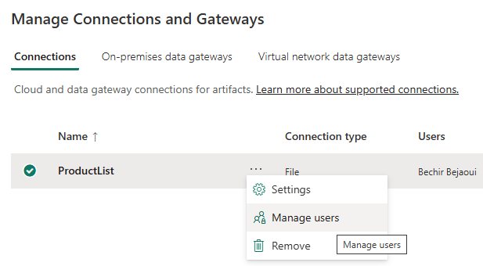
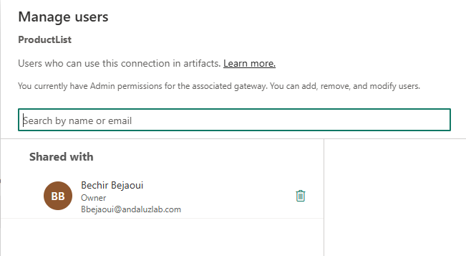
Deploy report
It is possible to share that data source connection with other in the workspace, by searching them by email and
adding them

Slide 15
Thank you
Thank you

